Slide 1

FOREIGN DIRECT INVESTMENT ANALYSIS
PRESENTED BY:-
VIKASH KUMAR MAHAPATRA

Slide 2
OBJECTIVE
The goal of this project is to understand the Foreign direct investment in India for the last 17 years from 2000-01 to 2016-2017.

Slide 3
PROBLEM STATEMENT
Investment is a game of understanding historic data of investment objects under different events but it is still a game of chances to minimize the risk we apply analytics to find the equilibrium investment.
To understand the Foreign direct investment in India for the last 17 years from 2000-01 to 2016-2017. This dataset contains sector and financial year.

Slide 4
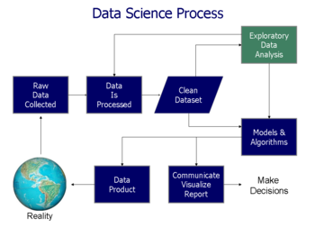
ARCHITECTURE

Slide 5
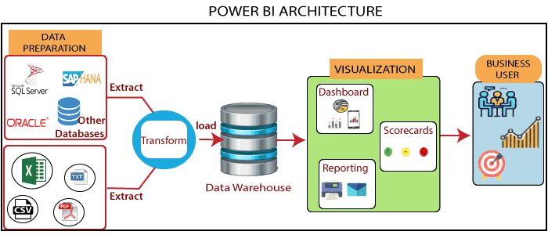
POWER-BI ARCHITECTURE

Slide 6
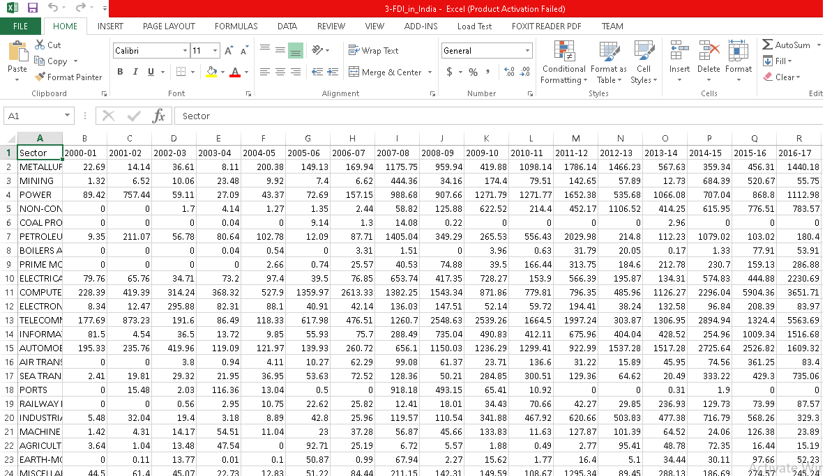
DATASET INFORMATION
The file name FDI_in_India.csv contains different sector names and period interval i.e. from 2000-2017 and contain amount received corresponding years against particular sectors. Sample data below.

Slide 7
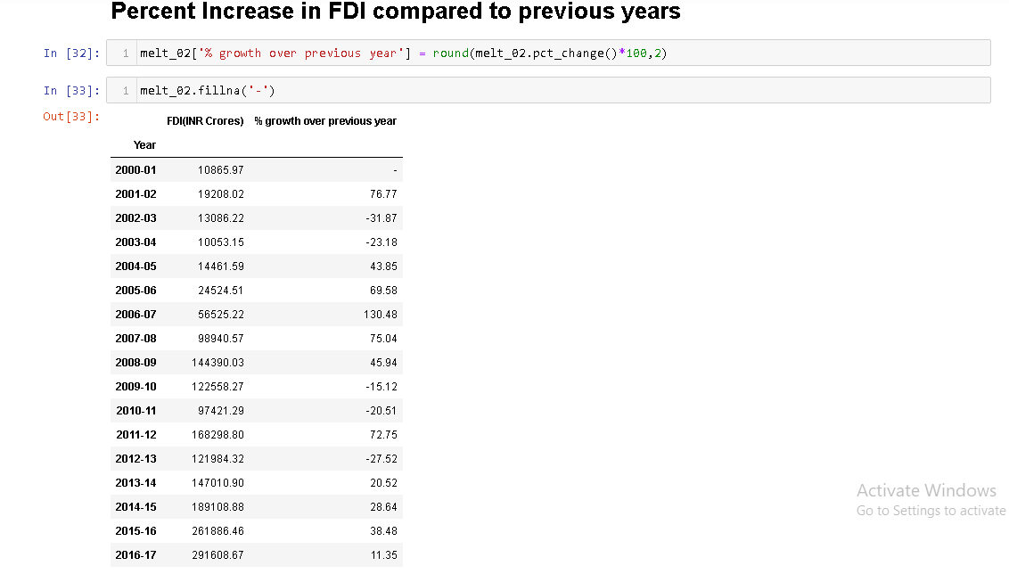
INSIGHTS

Slide 8
From the above figure we can see that there is 76.77 percent(Amount is RS 19208.02 CR) increase in investment in year 2001-02 compare to previous year 2000-01(Amount is RS 10865.97 CR).
There was dip in the year 2002-03 about 31.87 percent and 2003-04 about 23.18 percent.
Then see first major percent jump in FDI in year 2006-07 i.e. 130.48 percent (Amount RS 56525.22 CR) compared to previous year.
In year 2016-17 we received about RS 291608.67 CR which is huge as compared to first major jump in year 2006-07.

Slide 9
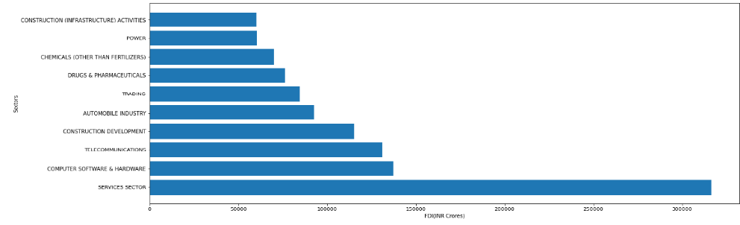
Below figure show most receiving FDI sectors we can see Service Sector almost 17 percent over the year of the total FDI, then computer software & hardware, telecommunication received 7 percent over the year of the total FDI.

Slide 10
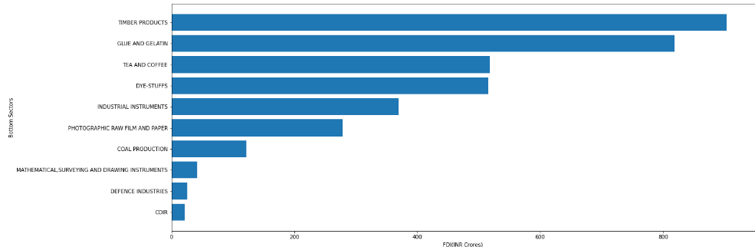
Below figure show least receiving FDI sectors we can see Coir, Defense Sector almost 0.001 percent over the year of the total FDI, glue & gelatin almost 0.046 percent over the year of the total FDI.

Slide 11
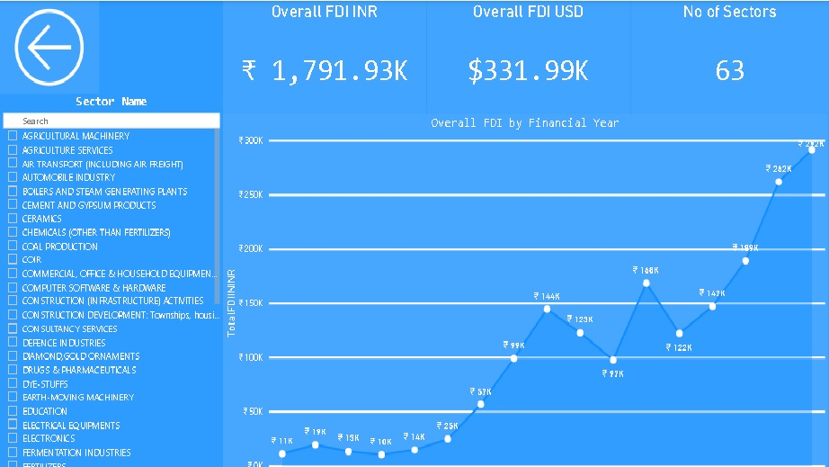

Slide 12
CONCLUSION
The Sectoral composition of FDI over the period of 2000-2017, we can find that the largest recipient of such investment is Service sector (Financial and non-financial services),comparing to all sector is 17.65 % of the total FDI inflow.
The top sector second most recipient is Computer software and Hardware, Telecommunication sector which shares 7% of the total FDI inflow. Construction development, Automobile Industry sector having 6%, 5% respectively.
The least receiving FDI over the year is COIR , Defense Industries having 0.001%.In them Dye-Stuffs , Tea & Coffee each received 0.029% . In them glue & gelatin received 0.046% is most of received FDI in bottom sector.
The foreign investors are interested in mainly financial services due to its profit generating advantage. This sector gives scope for the foreign investor to take back the profits to the home country.
Over the year there are some up and down in the FDI inflows ,major hike was in year 2006-07 i.e. 56,525 CR compare to previous year's. In 2015-16 inflows was almost 2,61,886 CR and 2016-17 inflows was almost 2,91,608 CR which in comparison to all previous year is highest received.

Slide 13
QUESTION AND ANSWER
What’s the source of data? The Dataset was taken from project documenthttps://drive.google.com/drive/folders/1M5z7z1NmWar7y1eFs67orfjqHL0iSV?usp=sharing
What was the type of data? It was combination of numerical and categorical values.
What were the libraries that you used in Python? I used Pandas , NumPy and Matplotlib libraries of python.
Do we have to download these libraries? To check whether you have it or not try pip list (you need to have pip install in system execute this command)if don’t find then download using pip install library name.
What techniques were you using for data? 1.Finding null values and datatypes. 2.Visualizing relationship between independent variables with each other and output variables. 3.Removing unwanted attributes, removing outliers, impute missing if required otherwise drop from dataset. 4. Transform your data the get desired result.

Slide 14
THANK YOU

